Slide 1
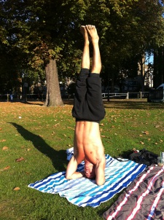
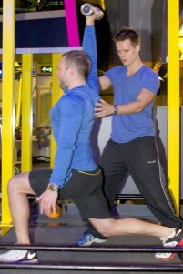
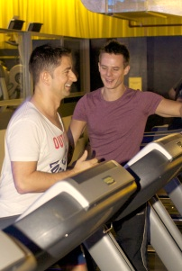
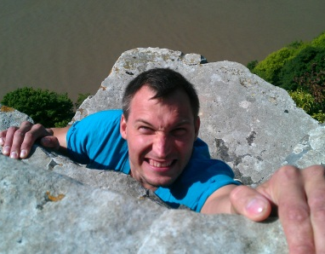
360°CHANGE
Personal Training
Healing
“You look like the way you move”
“Your body is a mirror of your consciousness”
Discover new ways of enjoying your body and your training. Push your boundaries, break your comfort zone and achieve the results you want!
An opportunity to go beyond your perceived limits, do things you thought were impossible, & recognize the unlimited nature of your being.
Assess your posture, mobility and strength
Burn fat, build muscle, feel great
Upgrade your fitness
Increase your flexibility
Improve your performance
Feel and connect to your body
Love and respect your physique
Heal physical and emotional issues
Reduce stress, improve health
Let go of energy blockages
Release tensions in the body
Sense your way to happiness
Find true, unconditional love
Awaken your soul
Nutrition
Coaching
Your body is a mirror of your eating habits!
Nurture your body
Learn simple tips with long-term results
Beat energy lows during the day
Eat the right foods
Your life, your hopes, your way!
Be who you are
Pursue the right goals
At a crossroads -find your new direction
Fulfil your destiny
Change your Life
Heal Yourself
Enjoy your Being
Clarify your Goals
Kick start your Fitness
“I thoroughly enjoyed my training with Will”
“Tony’s healing experience is a must”

Slide 2
Testimonials
How we do it
How to book
“A Journey to your Truth”
We educate and motivate you and focus on your individual situation. Your needs are unique and so is the support we give you. We combine our skills to help you develop the potential of your body, mind and spirit. At the end of this experience you will feel empowered, healthy, relaxed, and radiant. It will positively impact all aspects of your life.
Benefit from great value by purchasing the three-hour package. You may buy as many packages as you like or combine individual sessions into your personal program. Sessions are booked individually with each practitioner. Their own terms and conditions apply.
To ensure you receive the maximum personal attention and optimum results we recommend booking a minimum of 6 to 12 sessions, depending on your specific needs. A 10% discount is given when you purchase 6 or more sessions.
“What a fantastic journey I have had! This helped me to release blockages, gain clarity, insights, to relax and get some much needed healing. Tony has made a big difference. I now feel revitalised, focused on my goals and refreshed”
Jenny D, London
Three-Hour Package Offer £175
“I have thoroughly enjoyed training with Will; he understood my requirements and has exceeded my expectations. He has helped me choose the right training methods, nutritional advice, tricks and tips on correct techniques and posture which has been invaluable. .”
What’s Included
Personal Training and Nutrition with Will Pike at Gymbox Covent Garden* lasting 90minutes, during which he will discuss your goals and training, assess your mobility and run you through a suitable training programme (*entrance fee included)
Chakra Healing and Coaching with Tony Selimi lasting 90 minutes, during which he works on identifying blockages and healing your chakras, as well as giving you a taste of how to live a life that is true to who you really are.
Step 1 - Go to:
http://healoneself.wordpress.com
Click on the 360 Change Body, Mind and Spirit link and pay for your session.
Step 2 - To arrange your:
Personal Training and Nutrition session get in touch with Will Pike on 078 8984 2165 or e-mail will@willpike.co.uk
Healing and Coaching session get in touch with Tony Selimi on 078 1717 4708 or e-mail tonyselimi@me.com
For more information, email us:
bodymindspirit@willpike.co.uk
John N, London
“God where do I start - I found my twin soul, my new family and confirmation of who I am. Tony is a man who has found his purpose and passion; he helped me get back on track and given me the strength and energy to be the best I can be. His love for all is obvious; the experience he gives is a must!”
Christine H, Florida
“I really look forward to going to the gym and my training sessions with Will. This comes from someone who has never enjoyed exercise. I really enjoy Will’s style of training. He encourages me to meet my goals, but not in a pushy way. Overall I have seen real results and gained confidence in what I can achieve at the gym.”
individual sessions
60 minutes Personal Training £65
30 minutes Nutrition £30
60 minutes Healing £80
30 minutes Coaching £40
Neil D, London

Slide 3
Personal Training
How to book
360°CHANGE
“You look like the way you move”
Benefit from great value by purchasing the three-hour package. You may buy as many packages as you like or combine individual sessions into your personal program. Sessions are booked individually with each practitioner. Their own terms and conditions apply.
To ensure you receive the maximum personal attention and optimum results we recommend booking a minimum of 6 to 12 sessions, depending on your specific needs. A 10% discount is given when you purchase 6 or more sessions.
Discover new ways of enjoying your body and your training. Push your boundaries, break your comfort zone and achieve the results you want!
Assess your posture, mobility and strength
Burn fat, build muscle, feel great
Upgrade your fitness
Increase your flexibility
Improve your performance
Feel and connect to your body
Love and respect your physique
Step 1 - Go to:
http://healoneself.wordpress.com
Click on the 360 Change Body, Mind and Spirit link and pay for your session.
Step 2 - To arrange your:
Personal Training and Nutrition session get in touch with Will Pike on 078 8984 2165 or e-mail will@willpike.co.uk
Healing and Coaching session get in touch with Tony Selimi on 078 1717 4708 or e-mail tonyselimi@me.com
For more information, email us:
bodymindspirit@willpike.co.uk
Nutrition
Your body is a mirror of your eating habits!
Nurture your body
Learn simple tips with long-term results
Beat energy lows during the day
Eat the right foods
Change your Life
Heal Yourself
Enjoy your Being
Clarify your Goals
Kick start your Fitness
“I thoroughly enjoyed my training with Will”

Slide 4
Healing
Testimonials
How we do it
“Your body is a mirror of your consciousness”
“A Journey to your Truth”
We educate and motivate you and focus on your individual situation. Your needs are unique and so is the support we give you. We combine our skills to help you develop the potential of your body, mind and spirit. At the end of this experience you will feel empowered, healthy, relaxed, and radiant. It will positively impact all aspects of your life.
An opportunity to go beyond your perceived limits, do things you thought were impossible, & recognize the unlimited nature of your being.
“What a fantastic journey I have had! This helped me to release blockages, gain clarity, insights, to relax and get some much needed healing. Tony has made a big difference. I now feel revitalised, focused on my goals and refreshed”
Heal physical and emotional issues
Reduce stress, improve health
Let go of energy blockages
Release tensions in the body
Sense your way to happiness
Find true, unconditional love
Awaken your soul
Jenny D, London
Three-Hour Package Offer £175
“I have thoroughly enjoyed training with Will; he understood my requirements and has exceeded my expectations. He has helped me choose the right training methods, nutritional advice, tricks and tips on correct techniques and posture which has been invaluable. .”
What’s Included
Personal Training and Nutrition with Will Pike at Gymbox Covent Garden* lasting 90minutes, during which he will discuss your goals and training, assess your mobility and run you through a suitable training programme (*entrance fee included)
Chakra Healing and Coaching with Tony Selimi lasting 90 minutes, during which he works on identifying blockages and healing your chakras, as well as giving you a taste of how to live a life that is true to who you really are.
John N, London
Coaching
“God where do I start - I found my twin soul, my new family and confirmation of who I am. Tony is a man who has found his purpose and passion; he helped me get back on track and given me the strength and energy to be the best I can be. His love for all is obvious; the experience he gives is a must!”
Your life, your hopes, your way!
Be who you are
Pursue the right goals
At a crossroads -find your new direction
Fulfil your destiny
Christine H, Florida
“I really look forward to going to the gym and my training sessions with Will. This comes from someone who has never enjoyed exercise. I really enjoy Will’s style of training. He encourages me to meet my goals, but not in a pushy way. Overall I have seen real results and gained confidence in what I can achieve at the gym.”
individual sessions
60 minutes Personal Training £65
30 minutes Nutrition £30
60 minutes Healing £80
30 minutes Coaching £40
“Tony’s healing experience is a must”
Neil D, London

